Slide 1
Open data and industry-driven environment for multiphase and multiscale
Materials Characterization and Modelling combining
physics and data-based approaches

Slide 2
WP5 Open repository for knowledge transfer and data sharing
1st Review Meeting, 09 July 2024 [Online]
Presenter(s): Otilia Bularca (SIMAVI)
Iacob Crucianu (SIMAVI)

Slide 3
Outline
WP5 overview & expected outcomes
WP5 Outcomes (PR1)
Demo
WP5 tasks & progress
WP5 Deliveries timeline

Slide 4
WP5 overview
SIMAVI, AIMEN, SINTEF
87 PMs
M01-M42
CEA, RINA-C, CSM, HC, GENVIA, TME, TUW, ASRO
4 tasks, 3 deliverables
Developing a repository to store added value data sets and modelling tools (FAIR principles)
Implementing the repository in an open environment (facilitating re-use of existing research)
Establishing a High-level reference data management system to facilitate cross-database mapping of materials related data
Integration, testing and validating the tool
T5.1 Technical requirement definition for the framework (SIMAVI, M01-M09)
T5.3 AI-based mechanisms and functionalities (AIMEN, M09-M30)
T5.4 Technical testing and validation (SINTEF, M24-M42)
T5.2 Open repository for knowledge transfer and data sharing, integration and interoperability (SIMAVI, M06-M42 )

Slide 5
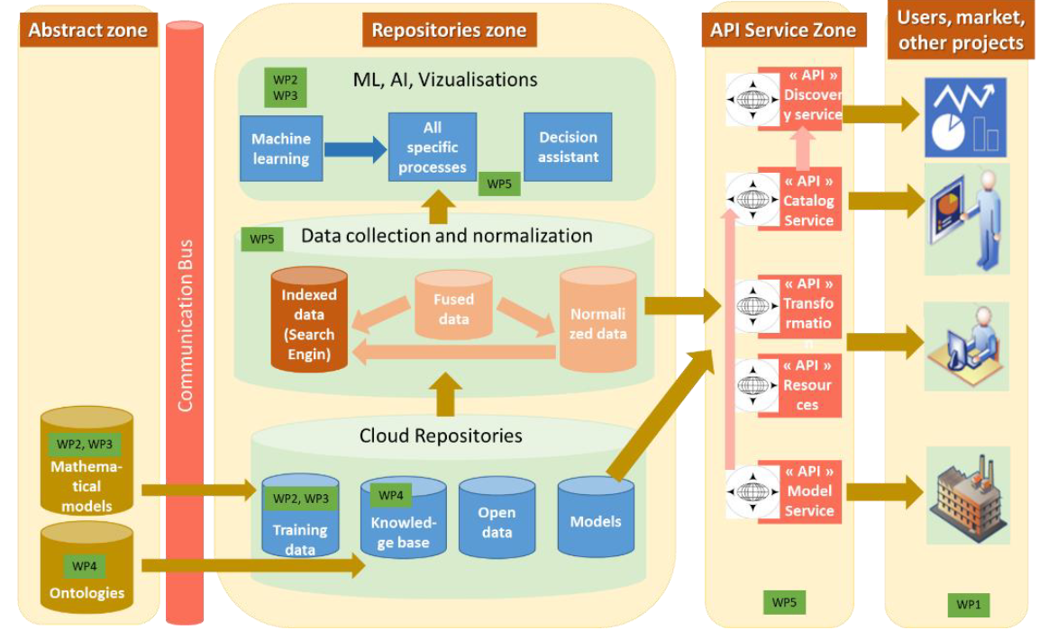
WP5 expected outcomes
Contributing to Data-Driven Materials Science environment through the implementation of an Open Repository Platform to enhance knowledge transfer, data and models sharing across EU-wide environment (STO4)
The MatCHMaker open data repository for storage and fast access to existing C&M data will be structured according three main zone
i) Abstract zone where the scientific knowledge is taken from (mathematical models and defined ontologies);
ii) repositories zone where data is stored and processed;
iii) API service zone where the resources from repositories are presented outside.
Starting with the knowledge of mathematical models and ontologies, several types of repositories are constructed
Notes:
Scientific and Technological Objectives (STO) 4 - Contributing to Data-Driven Materials Science environment through the implementation of an Open Repository Platform to enhance knowledge transfer, data and models sharing across EU-wide environment [WP5]
Developing a repository to store FAIR high added value data sets and modelling tools, validated through industry-relevant use cases
• Implementing the repository in an open environment to facilitate the re-use of existing research results on C&M as well as the uptake of new project results
• Establishing a High-level reference data management system to facilitate cross-database mapping of materials related data. In this context, MatCHMaker will provide tools supporting data documentation and easy‐to‐use libraries and APIs that applications can use to realise FAIR data principles
MatCHMaker open repository including Information & Data sharing system main components
Access to pre normalised Protocols & Open access solution for data treatment

Slide 6
WP5 tasks & progress

Slide 7
T5.1 Technical requirement definition for the framework
Leader: SIMAVI
Contributors: RINA-C, CEA, AIMEN, TU WIEN IMWS, HC, TME, GENVIA
Duration: M01-M09
Objectives:
the definition of the technical specifications and software architecture of MatCHMaker open repository and framework according to different “zones” (abstract, repositories and API service)
Output: D5.1 Technical specifications of the Open Repository , SIMAVI (M09)

Slide 8
T5.1 Approach
GA provisions
info from tech ad industry partners
Screening the existing technologies for repositories
Identify gaps and limitation
Propose a new concept (Distributed Data and Knowledge Mesh)
Define the deployed methodology
Present the architecture design
Input from partners
SotA
GA provision
New concept - DDKM
Methodolgy deployed
Architecture design
Notes:
Several steps were followed to identify the technical requirements of the open repository and to draft the architecture. Figure 1 presents the sequence of activities performed to define the Open Data Repository architecture. Starting from the GA provisions, collecting input from technology and industry partners, while screening the existing technologies for repositories and identifying the gaps and limitations of available approaches and tools were identified, and a new concept was developed to meet the needs and achieve the objectives of MatCHMaker project.

Slide 9

Architecture requirements as per GA
Data and knowledge storage and archiving
Data and knowledge retrieval and discovery
Data audit and tracking
Verification of authenticity
API access
Collaboration features
Decentralization
Domain ownership
Standardization
Data governance

Slide 10
Tools survey
Name of the tool | <Please add the name of the tool / proof of concept>
Leading partner | <please include the name of the partner leading the tool and the contributing partners (if any)>
The main role in processing data | <please provide details about the role in data processing>
The short description of functionalities | <please provide a list of the main features anticipated>
Data outputs | <please provide the outputs (features, data) that the tool will provide>
Model outputs | <please provide details about the data format e.g., XML, CSV, etc>
Implementation details | <Please add details about Operating System, technologies, availability, etc>
TOOLS
Experimental data acquisition (SINTEF)
ML tools to optimize C&M workflows (AIMEN)
Parametric model for materials sustainability assessment (RINA)
Advanced data acquisition (CEA)
ML tools for data analysis (CEA)
Advanced models for materials degradation (CEA)
Advanced model for materials sustainability assessment (RINA)
Semantic data models (SINTEF)
Domain ontologies (SINTEF)
Application ontologies (AIMEN)

Slide 11
State of the art analysis
Open repositories for materials
The Materials Project (The Materials Project, 2023) - a database of materials properties, including crystal structures, electronic structures, and thermodynamic properties.
Materials Cloud (Materials Cloud, 2023)- a platform for sharing materials simulations, including codes, data, and workflows.
NOMAD Repository (NOMAD, 2023) - a database of materials simulations data, including input files, output files, and metadata.
MatWeb (MatWeb, 2023) - a database of materials data, including physical, thermal, and mechanical properties.
NIST Materials Data Repository (Materials Data Repository, 2023) - a repository of materials data, including crystal structures, thermodynamic properties, and phase diagrams.
Open knowledge repositories
GitHub (GitHub, 2023) - a web-based hosting service for version control and collaboration that provides a platform for hosting open-source software projects.
GitLab (GitLab, 2023): a popular web-based Git repository manager that offers a wide range of features, including issue tracking, continuous integration, and deployment.
Bitbucket: a web-based hosting service for Git and Mercurial repositories, providing features such as code collaboration, continuous integration, and deployment.

Slide 12
Gaps & limitations identified
They are centralized. Partial content can be locally stored but limited to projects.
If they are domain-specific, limited functionality for subdomains exists.
It is not possible to manage models and data in the same repository.
It is not possible to maintain models by applying ML to data presented in the repositories.
There is no authenticity verification.

Slide 13
Needs
Principles
Concepts
Domain ownership
Data as a product
Self-serve data infrastructure platform
Federated governance
Data Mesh
Knowledge Mesh
Distributed system
Peer to Peer (P2P)
DDKM (Distributed Data and Knowledge Mesh)

Slide 14
Selected methodology
Kruchten 4+1 View Model
View-based methodology
mainly focuses on the architecture and offers a clear view for all stakeholders.
Data-Driven Software Architecture (DDSA)
Used for architectural pattern
aims to provide objective data-driven insights into the performance and quality of the software system,
helps identify areas of the system that may require refactoring or redesign.
Notes:
More, in the outcome section..

Slide 15
T5.1 Technical requirement and architecture definition for the framework (SIMAVI)
List of partners contributing to task
Communication with WP1 – T1.1 leader (RINA) to follow the progress
Architecture design
D1.5 edited, reviewed, and submitted
N/A
Done
In Progress
N/A (results of T5.1 handed over to T5.2)
N/A
Planned
CommentS / NEWS

Slide 16
T5.2 Open repository for knowledge transfer & data sharing, integration and interoperability
Leader: SIMAVI, Contributors: CEA, AIMEN, TU WIEN, Duration: M06-M42
Objectives:
The data collected and generated in T2.1, T2.2, T3.1,T3.2, T3.3 and the results achieved in WP4 will serve as base for the generation of a digital tool, hosting all the relevant knowledge to provide decision making support for users.
build a mechanism store and to expose metadata, data, information, and knowledge :
i) A secured data store, where metadata and data will be registered;
ii) A physical representation of the links and dependencies between ontology data;
iii) A search engine able to retrieve data based on complex queries on ontologies or based on examples.
focus also on a number of technological improvements by seeking integration opportunities with existing EU platforms that provide data or materials modelling marketplaces (e.g. AI4EU, OntoTrans, DOME 4.0), ensuring knowledge transfer, early adoption, joint activities and sustainability during and after the end of the project
Output: D5.2 MatCHMaker Open Repository , SIMAVI (M30)
Notes:
Methods for Caracterization & Modelling – both for screening and behaviour understanding of materials (WP2, 3)
Wp4 – rely on it for helping us with structuring the data – defining the ontologies

Slide 17
T5.2 Open repository for knowledge transfer and data sharing, integration and interoperability
started working on the implementation of the Open repository
installing needed/necessary programs
configure programs
prepared a demo
Following the progress of WP2 Characterisation and Modelling methods, WP3 Advanced Characterisatio and Modelling methods and WP4 Onthology
Build the mechanism store and to expose metadata, data, information, and knowledge
Done
In Progress
Take-over the data collected and generated in T2.1, T2.2, T3.1,T3.2, T3.3
Assessment of integration opportunities
Management of data spaces (projects) as part of Knowledge and Data Mesh
Main functions of the Repository related to collaborative working: add data and knowledge: Commit, Push, Pull
Representation of ontologies
Interaction with users
The task started in M6 (May-23)
Planned
CommentS / NEWS

Slide 18
T5.3 AI-based mechanisms and functionalities
Leader: AIMEN Contributors: SIMAVI, CEA
Duration: M9-M30
Objectives
The separation of data from the application (or business) rules and presentation creates a flexible environment where changes in each layer leave other layers unaffected.
The AI based mechanisms will be able to work on ontologies, and based on the application of ML, it will identify dependencies, links, generalizations or similarities between stored concepts.
Data fusion, Regression or Graph specific elements will be part of this mechanisms.
the main functionalities will be extraction of knowledge and data management, data visualization (handling the presentation and interaction with the user), smart search, trace data origin / provenance, data postprocessing,
Output: D5.2 MatCHMaker Open Repository, AIMEN (M42)
Notes:
T5.3 AI-based mechanisms and functionalities leaded by AIMEN - ASOCIACION DE INVESTIGACION METALURGICA DEL NOROESTE (ES) and assited by CEA - COMMISSARIAT A L ENERGIE ATOMIQUE ET AUX ENERGIES ALTERNATIVES (FR) and SIMAVI is a taks that will deliver its results as part of D5.2 alos.
The scope of this task is to build an AI based mechanism that will be able to work on ontologies and based on the application of ML. It will identify dependencies, links, generalizations or similarities between stored concepts.
Data fusion, Regression or Graph specific elements will be part of this mechanisms, while extraction of knowledge and data management, data visualization, smart search, trace data origin / provenance, data postprocessing will be among the main functionalities.

Slide 19
T5.3 AI-based mechanisms and functionalities
Literature review based on ACUMOS AI.
Evaluation of ACUMOS AI requirements for uploading the AI-based mechanisms and functionalities and how they will be linked with the databases generated during the project.
Evaluation of using the ZENODO repository or the ACUMOS AI, considering the benefits of using one or the other.
Alignment of the ontologies with the AI tools. (WP4)
Done
In Progress
Selection of ML models based on the ontologies data structure.
Discussion with the consortium to choose which platform to use, ZENODO or ACUMOS AI.
Demonstration of how to use the uploaded AI models in the platform
The task started in M9 (Aug-23)
Planned
CommentS / NEWS

Slide 20
T5.3 Next steps
To design AI mechanisms to work with ontologies, identifying dependencies, links, generalizations, and similarities between concepts.
To integrate these mechanisms to enhance data processing and knowledge extraction,
To develop dynamic algorithms that adapt to new data and evolving requirements, ensuring flexibility and scalability.
To develop advanced data visualization tools to facilitate user interaction and comprehension of complex data sets, ensuring they are dynamic and allow real-time exploration and interaction with data.

Slide 21
T5.4 Technical testing & validation
Leader: SINTEF Contributors: HC, TME, GENVIA, CEA,
Duration: M24-M42
Objectives:
ensure that all components communicate smoothly and are accessible by the end-users through the visualization layer.
a continuous testing approach will be followed, through execution in development stages immediately preceding the actual deployment of software (early identification of performance issues and bugs)
Continuous testing will be bootstrapped with the set-up of pilots, automatically generated based on model specifications.
Output: D5.3- Testing report, SINTEF (M42)

Slide 22
WP5 Deliveries timeline
D5.1
D5.2
D5.3
Submitted
Planned
Forthcoming
SIM
SEN
M09
SIM
PU
M30
SINTEF
SEN
M42
MatCHMaker Open Repository
Technical specifications of the Open Repository
Testing report

Slide 23
WP5 Outcomes

Slide 24
Architecture requirements
Functions
Features
Data and knowledge storage and archiving
Data and knowledge retrieval and discovery
Data audit and tracking
Verification of authenticity
API access
Collaboration features
Decentralization
Domain ownership
Standardization
Data governance

Slide 25
Needs: C&M
DDKM (Distributed Data and Knowledge Mesh)
Principles
Concepts
Domain ownership
Data as a product
Self-serve data infrastructure platform
Federated governance
Data Mesh(https://www.datamesh-architecture.com/)
Knowledge Mesh
Distributed system
Peer to Peer (p2p)
DDKM(Distributed Data and Knowledge Mesh)
Notes:
The data mesh concept is a way of organizing data infrastructure to enable teams to manage their own data domains, while still maintaining consistency and coherence across the entire organization.
C&M: Characterisation and Modelling

Slide 26
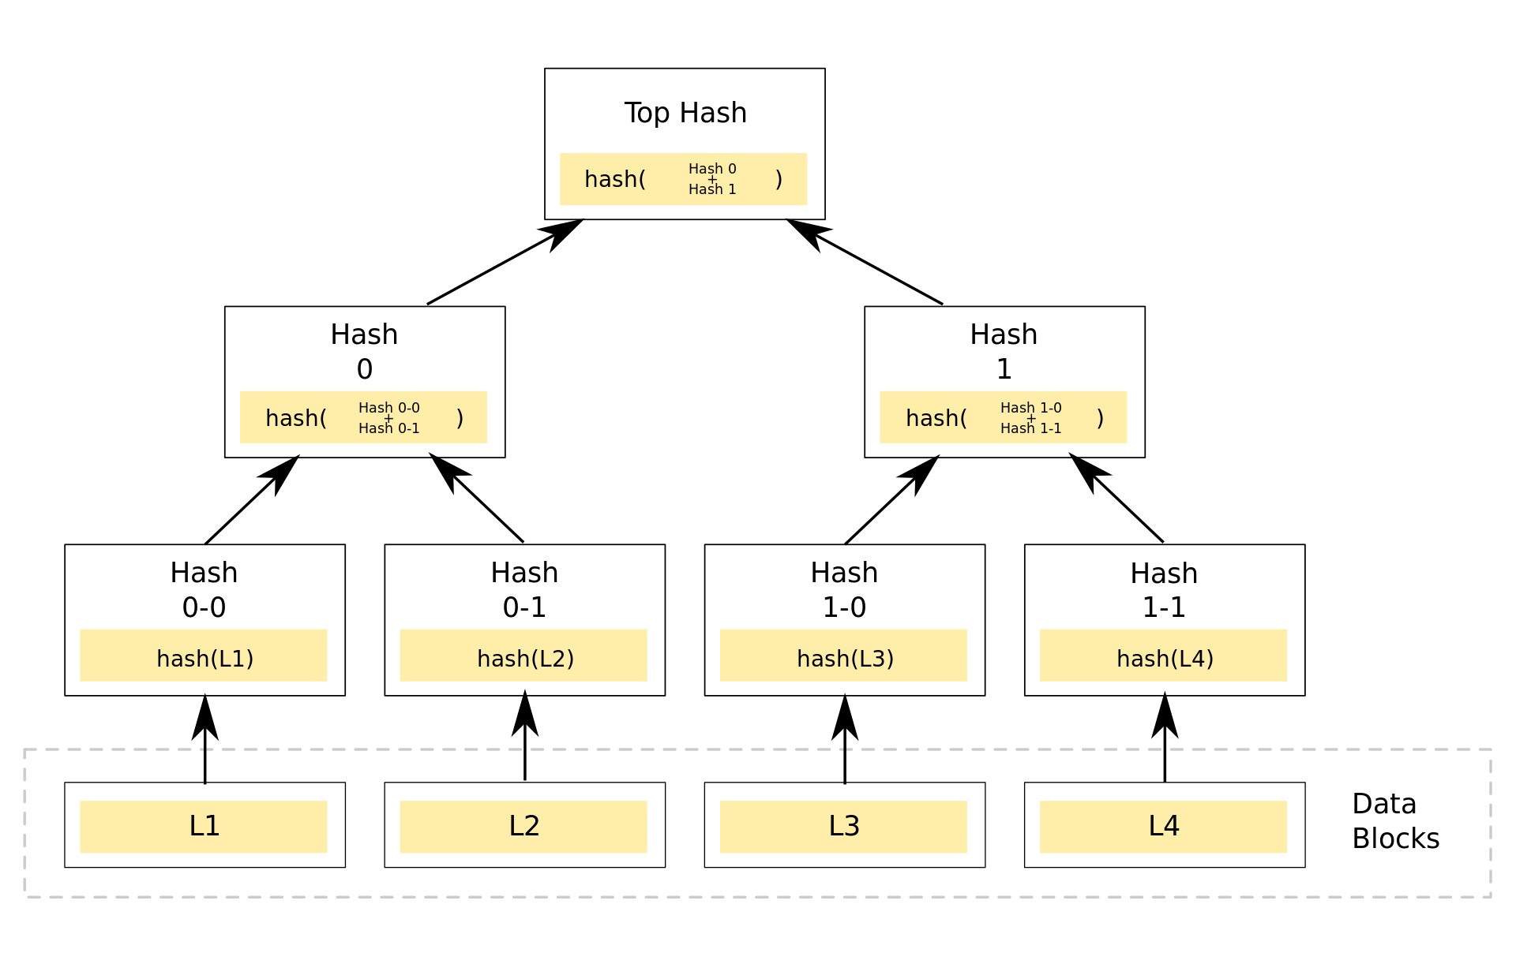
Distributed approach
Matchmaker 1
Matchmaker 3
Matchmaker 2
Matchmaker 3
Matchmaker 4
P2P
P2P
P2P
P2P
P2P
W
W
W
W
W
W
W
W
W
W
W
W
W
W
W
workspaces

Slide 27
DDKM Logical View

Slide 28
The First step for MatCHMaker
Materials Cloud
NOMAD Repository
MatWeb
NIST Materials Data Repository
The Materials Project
MatchMaker
Seed Node
SIMAVI
W
W
W
W
W
W
W
W
W
W
W
W
28

Slide 29
The First nodes deployed
Materials Cloud
NOMAD Repository
MatWeb
NIST Materials Data Repository
The Materials Project
MatchMaker
Seed Node
P2P
P2P
Pilot 2
Pilot 1
SIMAVI
W
W
W
W
W
W
W
W
W
W
W
W
29

Slide 30
Full deployment
Materials Cloud
NOMAD Repository
MatWeb
NIST Materials Data Repository
The Materials Project
MatchMaker
Seed Node
P2P
P2P
P2P
P2P
SIMAVI
Pilot 1
Pilot 2
Pilot 3
Pilot 4
Pilot 5
W
W
W
W
W
W
W
W
W
W
W
W
30

Slide 31
Client(wallet) Logical View
workspaces

Slide 32
Data flow
NOMAD Repository
NIST Materials Data Repository
Materials Cloud
MatWeb
Data source
MatchMaker
Seed Node
Define workspace/repo
Collect or create data in the workspace
Create links, index, hashes
Store the created artifacts
5. Define or Access workspace/repo
6. Collect or create data in the workspace
7. Create links, index, hashes
8. Store the created artifacts
Pilot 1
Pilot 2
SIMAVI

Slide 33
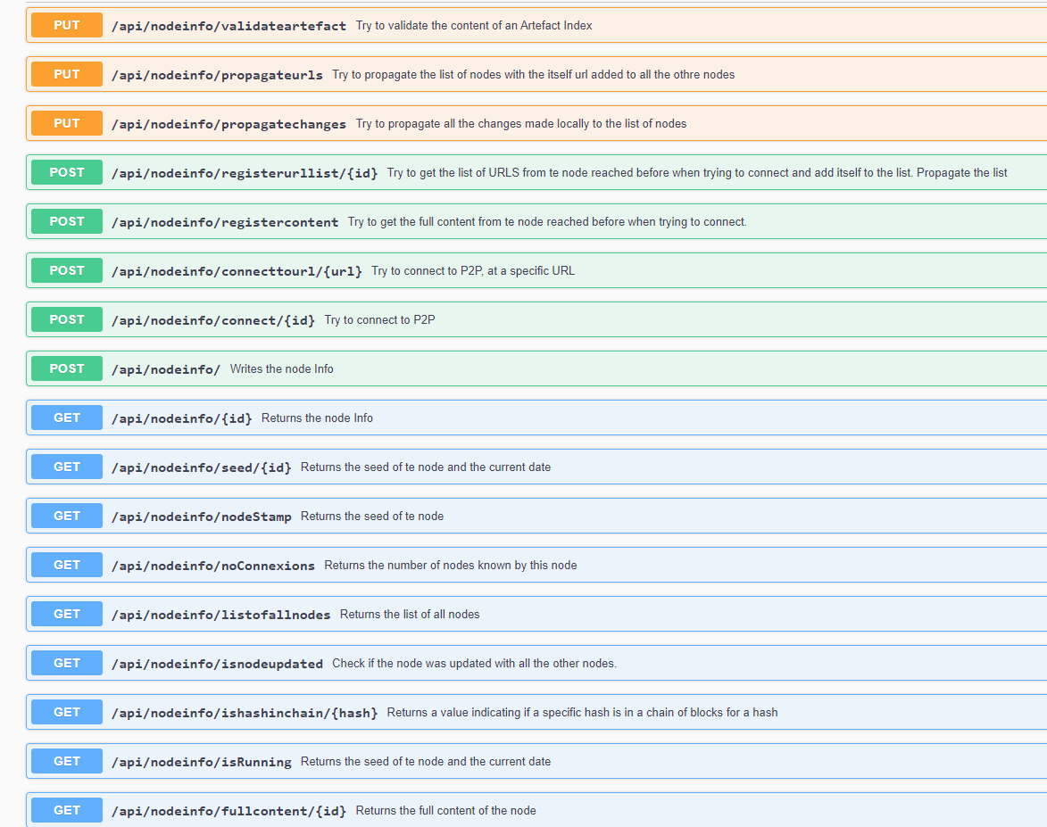
Horizontal data communications
Demo

Slide 34
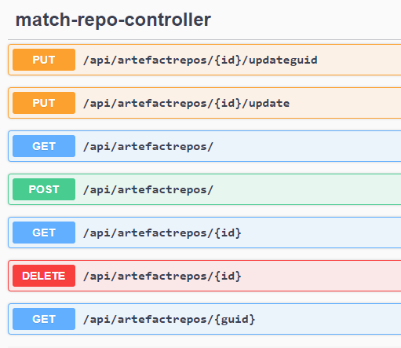
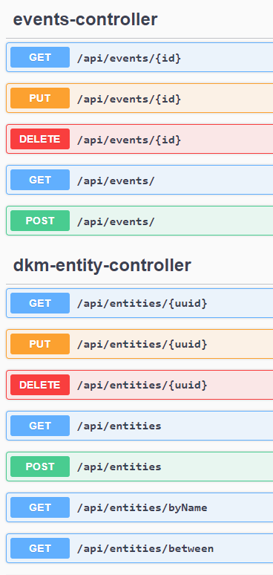
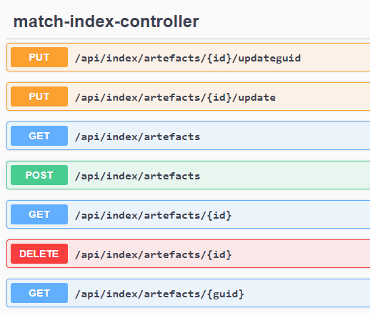
Vertical data communications
Demo

